Slide 1
Drone delivery service
System design and architecture solutions

Slide 2
Brief introduction
In this presentation I will provide a system design and architectural solution for delivery service with drones.
I will show and describe every class, method and algorithm that can be used.

Slide 3
Classes
The list of required classes: OrderService, Order, Drone, Charger, Position

Slide 4
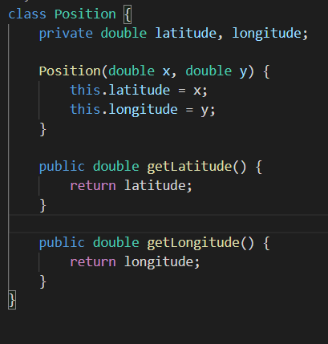
Position class
In the Position class we have two private fields latitude and longitude.
Longitude and Latitude help us to represent current position of some object. You can read more about it https://en.wikipedia.org/wiki/Geographic_coordinate_system
We have constructor that accepts latitude and longitude values as double representation of degrees, and getter methods as well

Slide 5
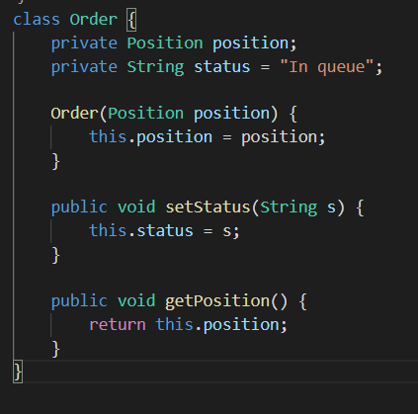
Order class
In the Order class we have two private fields position and status
We have a constructor which accepts position of order address. Also we have setStatus and getPosition methods

Slide 6
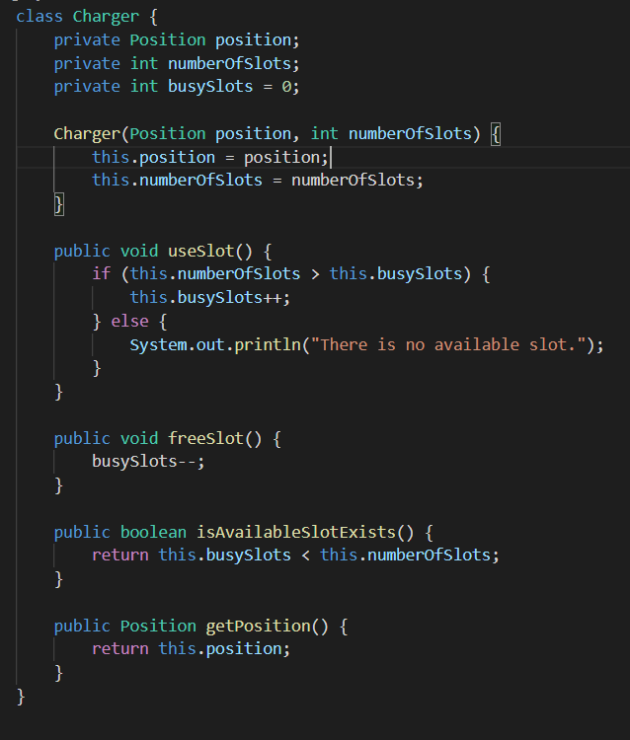
Charger class
We need chargers for charging our drones.
In the Charger class we three private fields position, numberOfSlots, busySlots
We have a constructor which accepts position of charger address and numberOfSlots
We have useSlot, freeSlot, isAvailableSlotExists and getPosition

Slide 7
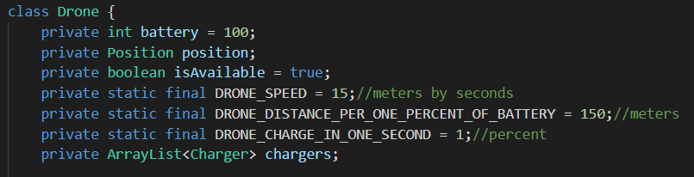
Drone class: fields
This is the largest class.
We have 7 private fields, 3
of them are static final,
cause we don’t need to
change their values.
Battery - power of drone
Position - coordinates of drone
isAvailable - availability of drone
chargers - list of chargers
DRONE_SPEED - speed of drone m/s, DRONE_DISTANCE_PER_ONE_PERCENT_OF_BATTERY - distance per one percent of battery, DRONE_CHARGE_IN_ONE_SECOND - charging speed

Slide 8
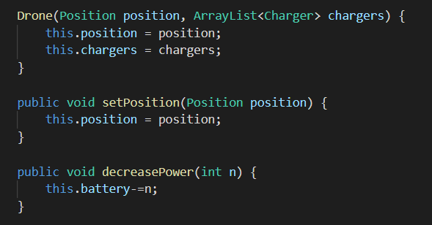
Drone class: methods - part 1
Constructor - accepts position of drone and list of chargers.
setPosition - accepts a new position of drone
decreasePower - decrease battery power of drone by n

Slide 9
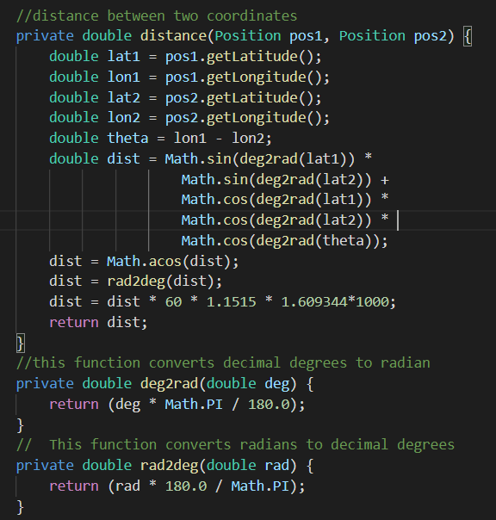
Drone class: fields - part 2
Distance method using the algorithm of calculating distances between two coordinates.
Helper methods for converting degrees to radians and vice versa

Slide 10
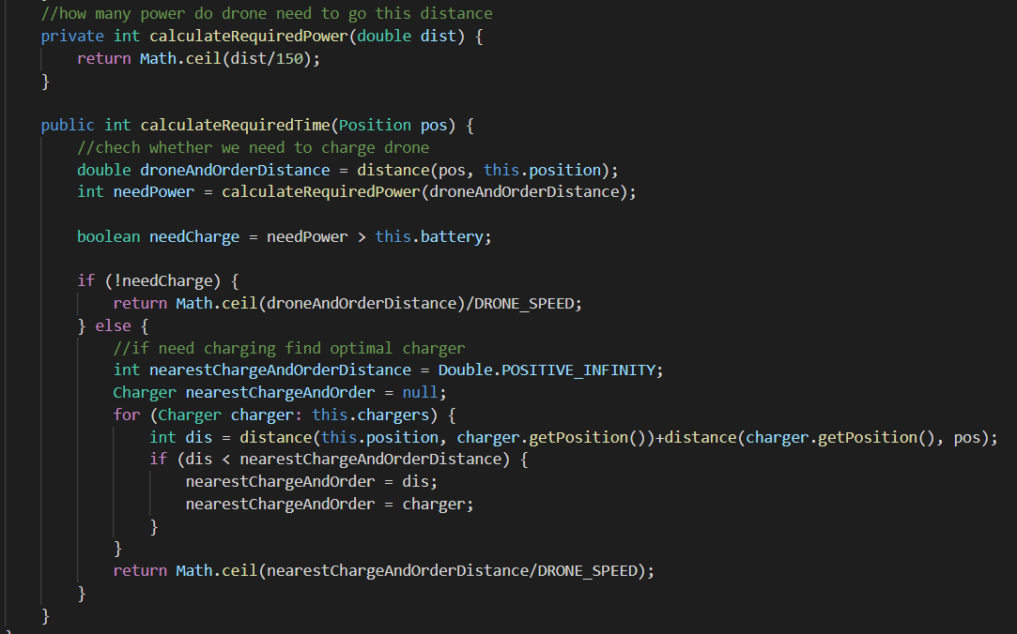
Drone class: fields - part 3

Slide 11
Drone class: fields - part 3
calculateRequiredPower method calculates how much power do dron need to complete distance
calculateRequireTime method accepts position of order address and calculates required time to complete delivery. If dron does not have enough power, we will calculate shortes distance dron -> charger, charger -> order position for every charger so that it will be the shortest path between dron and order coordinates.

Slide 12
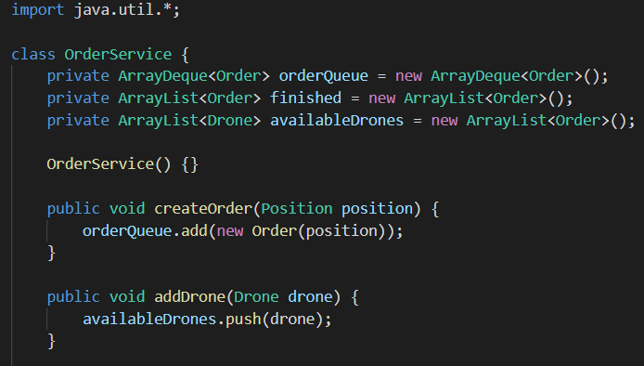
OrderService class - part 1
Here is the main part.
We have three fields: orderQueue, finished, availableDrons.
createOrder and addDrone methods

Slide 13
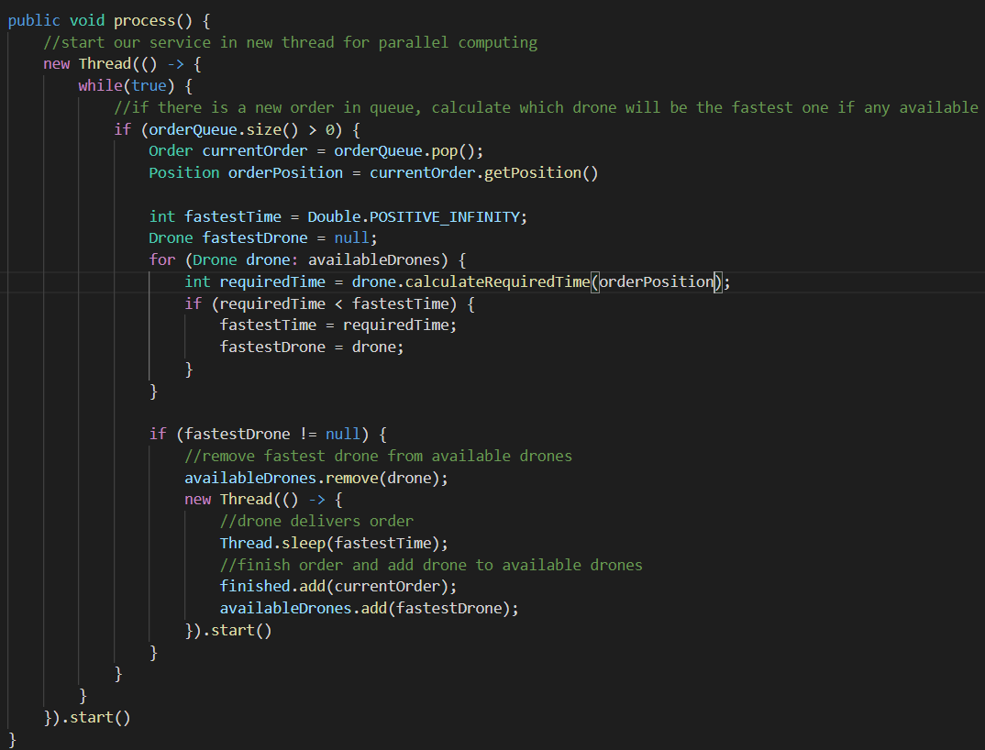
OrderService class - part 2

Slide 14
OrderService class - part 2
Here is the main method called process which starts out service in the new Thread so that you can createOrder and addDrone and other actions in one time with processing orders.
Algorithm is about checking if we have orders in queue and if it is, we will find the fastest drone (including the time for charging using calculateRequiredTime method for every drone). We should pop order from queue and remove drone from list of available drones
After we found fastest drone, we simply create a new Thread for delivering, and run sleep method of Thread to simulate delivery time and add order to finished orders array and add drone to available drones.

Slide 15
Conclusion
We have architecture of delivery service and used algorithms for finding distance between geographic algorithms, finding the shortest path with dependencies such as battery of drone. And used formulas to calculate delivery time, battery change etc.

